Slide 1
“ Smart Women Safety System”
Presented by
Humera khan Roll No - BETN1AI23054
Anuj Pratap singh Roll No - BETN1AI23048
Sumit Sharma Roll No - BETN1AI23023
Under the guidance of
Mr. Manish Kumar Jain
Designation
Assistant Professor, Department of CSA SOET ,
ITM University, Gwalior (M.P.)

Slide 2
Presentation Outline
Objective of Project/PBL
Introduction
Literature survey
Expected Gap in Literature survey
Project/PBL Methodology
Hardware and Software Requirement
DFD/ER/Flowchart Of The Project
Expected Output
Conclusion / Summary
Future Scope
References

Slide 3
Objective of Project/PBL
To develop a smart women safety system that can automatically detect danger situations.
To provide instant emergency alerts without requiring manual action.
To enable real-time location tracking for quick help.
To use AI-based voice and motion detection for identifying distress.
To ensure quick response and safety support during emergencies.

Slide 4
INTRODUCTION
Women safety is a major concern in today’s world, especially when traveling alone or in unsafe areas. Many safety applications are available, but most of them depend on the user to manually press an SOS button during an emergency.
In real-life situations, the victim may not always be able to use the phone due to fear, panic, or sudden danger.
To solve this problem, our project introduces a Smart Women Safety System that uses Artificial Intelligence to automatically detect danger. The system can identify distress through voice commands, phone movements like shaking, and location tracking.
Once danger is detected, it automatically sends alerts to emergency contacts along with live location and starts recording audio for evidence.
This system aims to provide quick, reliable, and automatic safety support without depending on user action.
Objective of Project/PBL

Slide 5
Literature survey
Existing apps like safety apps provide:
SOS button
Location sharing
Research papers focus on:
GPS tracking
Basic alert systems
Some systems use:
Wearable devices
Emergency messaging
❗ Limitation:
No intelligent detection
No real-time AI-based analysis

Slide 6
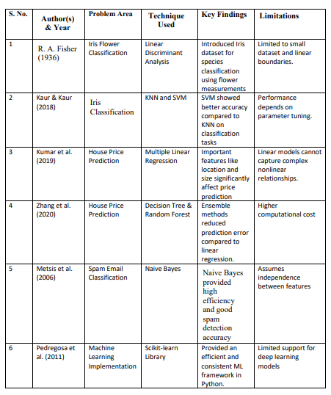
Literature Survey

Slide 7
Expected Gap in Literature survey
No automatic danger detection
No voice-based AI recognition
No multi-trigger system (voice + shake + behavior)
No predictive safety features
Lack of real-time smart decision making
“Our system fills the gap between passive safety and active protection.”
“Existing systems react after danger, our system detects danger before response is needed.”

Slide 8
Project/PBL Methodology
User Registration: User installs the app and adds emergency contacts.
Continuous Monitoring: System continuously monitors voice, phone movement (shake), and location.
AI-Based Detection: AI analyzes voice commands (like help) and unusual movements to detect danger.
Automatic Emergency Trigger: When danger is detected, the system automatically activates emergency mode.
Alert & Response:
Sends alert message to contacts
Shares live location
Starts audio recording

Slide 9
Hardware /Software Requirement
Hardware Requirements:
Android Smartphone
GPS Sensor
Internet Connectivity
Software Requirements:
Frontend: Flutter / Android Studio
Backend: Node.js / Firebase
AI Module: Python (Voice detection)
Database: MongoDB / Firebase
APIs: Google Maps API

Slide 10
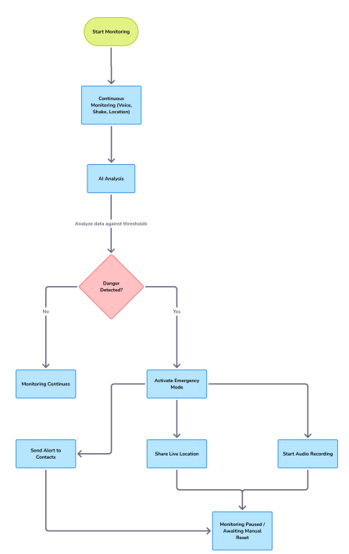

Slide 11
Expected Output:
Automatic detection of emergency situations using AI
Instant alert message sent to emergency contacts
Real-time GPS location sharing
Automatic audio recording during emergencies
Safe route suggestions for secure travel
Quick and reliable response without manual action

Slide 12
Conclusion / Summary
This project presents a smart and intelligent solution to enhance women safety. It reduces human dependency and uses AI for automatic detection and response.
The system is reliable, fast, and practical for real-world situations
“Technology becomes a silent protector.”

Slide 13
Future Scope
Integration with smartwatches
Facial recognition for threat detection
Crime hotspot prediction using AI
Direct connection with police systems
Wearable safety devices

Slide 14
Reference
Google Maps Platform Documentation – for location tracking https://developers.google.com/maps
Firebase Documentation – for backend and real-time database https://firebase.google.com/docs
SpeechRecognition Library Documentation – for voice detection https://pypi.org/project/SpeechRecognition/
Research Paper: “Women Safety System using IoT and GPS” International Journal of Engineering Research & Technology (IJERT)
Research Paper: “Smart Women Safety System using AI” IEEE Xplore Digital Library
Android Developer Documentation – for mobile app development https://developer.android.com

Slide 15


